Slide 1
Image edge information extraction system based on FPGA
01
05
基于FPGA的图像边缘信息提取系统
汇报人：陈思佑 张旭东
2023.04.03

Slide 2
CONTEN TS
Background and Significance
System design
Functions and results

Slide 3
Background and Significance
02
05
01

Slide 4
Background and Significance
Edge detection is an important technology in digital image processing, which can extract the contour information of objects and support the application of image recognition, segmentation and target tracking.
.
FPGA technology is widely used in the field of digital signal processing, which can realize high-speed parallel processing. The combination of FPGA, camera and VGA can realize the collection, processing and output of image information
Using the high performance calculation and programmability of FPGA, the edge information is extracted and output to the display screen, so as to realize efficient digital image processing.
Background
Significance
Objectives

Slide 5
System design
03
05
02

Slide 6
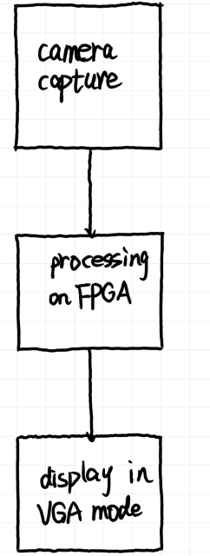
System framework design
Image acquisition module: The camera module is used to collect external video signals and convert them into digital signals and input them into FPGA.
Image processing and edge detection module: image preprocessing using FPGA. Then the edge detection operation is carried out to extract the image edge information.
VGA output module: output the processed image signals to the VGA display screen and display them through the display screen.

Slide 7
Camera acquisition and processing
Step 1
Step 2
Step 3
Initial
Acquisition
Store
The collected video data is continuously written to SDRAM through the FIFO register.
FPGA initially configures the camera through the IIC bus protocol.
The camera focuses and captures images.

Slide 8
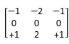
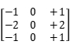
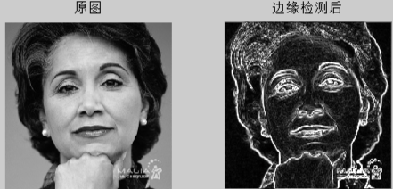
Edge extraction algorithm
Sobel operator
Sobel operator is one of the most commonly used edge detection algorithms, which detects edges based on the gradient change of gray values around pixel points. The advantages are simple and easy to implement, fast computing speed, suitable for image processing. The disadvantage is that it is easy to be affected by noise and the edge detection result may not be accurate enough.

Slide 9
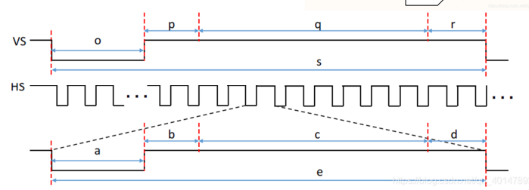
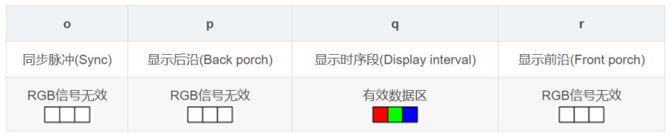
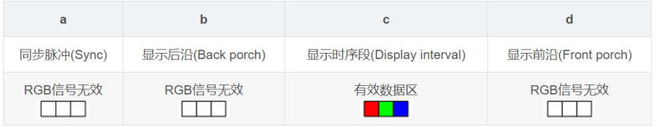
VGA display

Slide 10
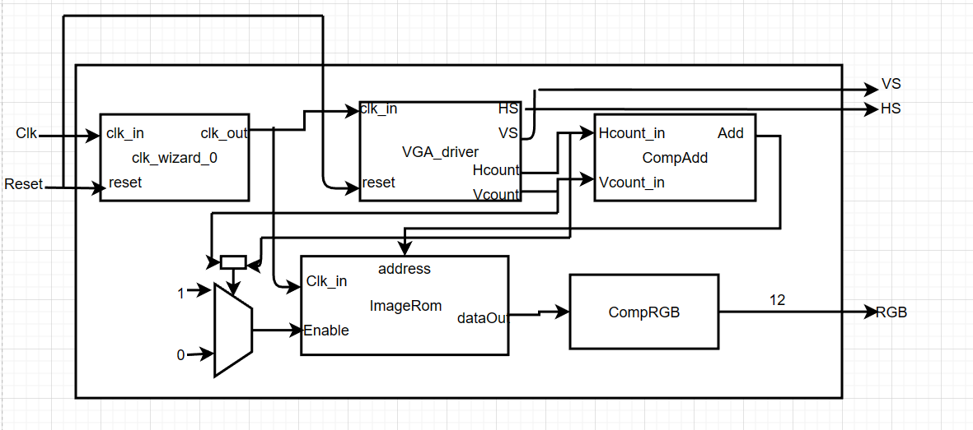
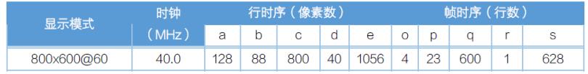
VGA display

Slide 11
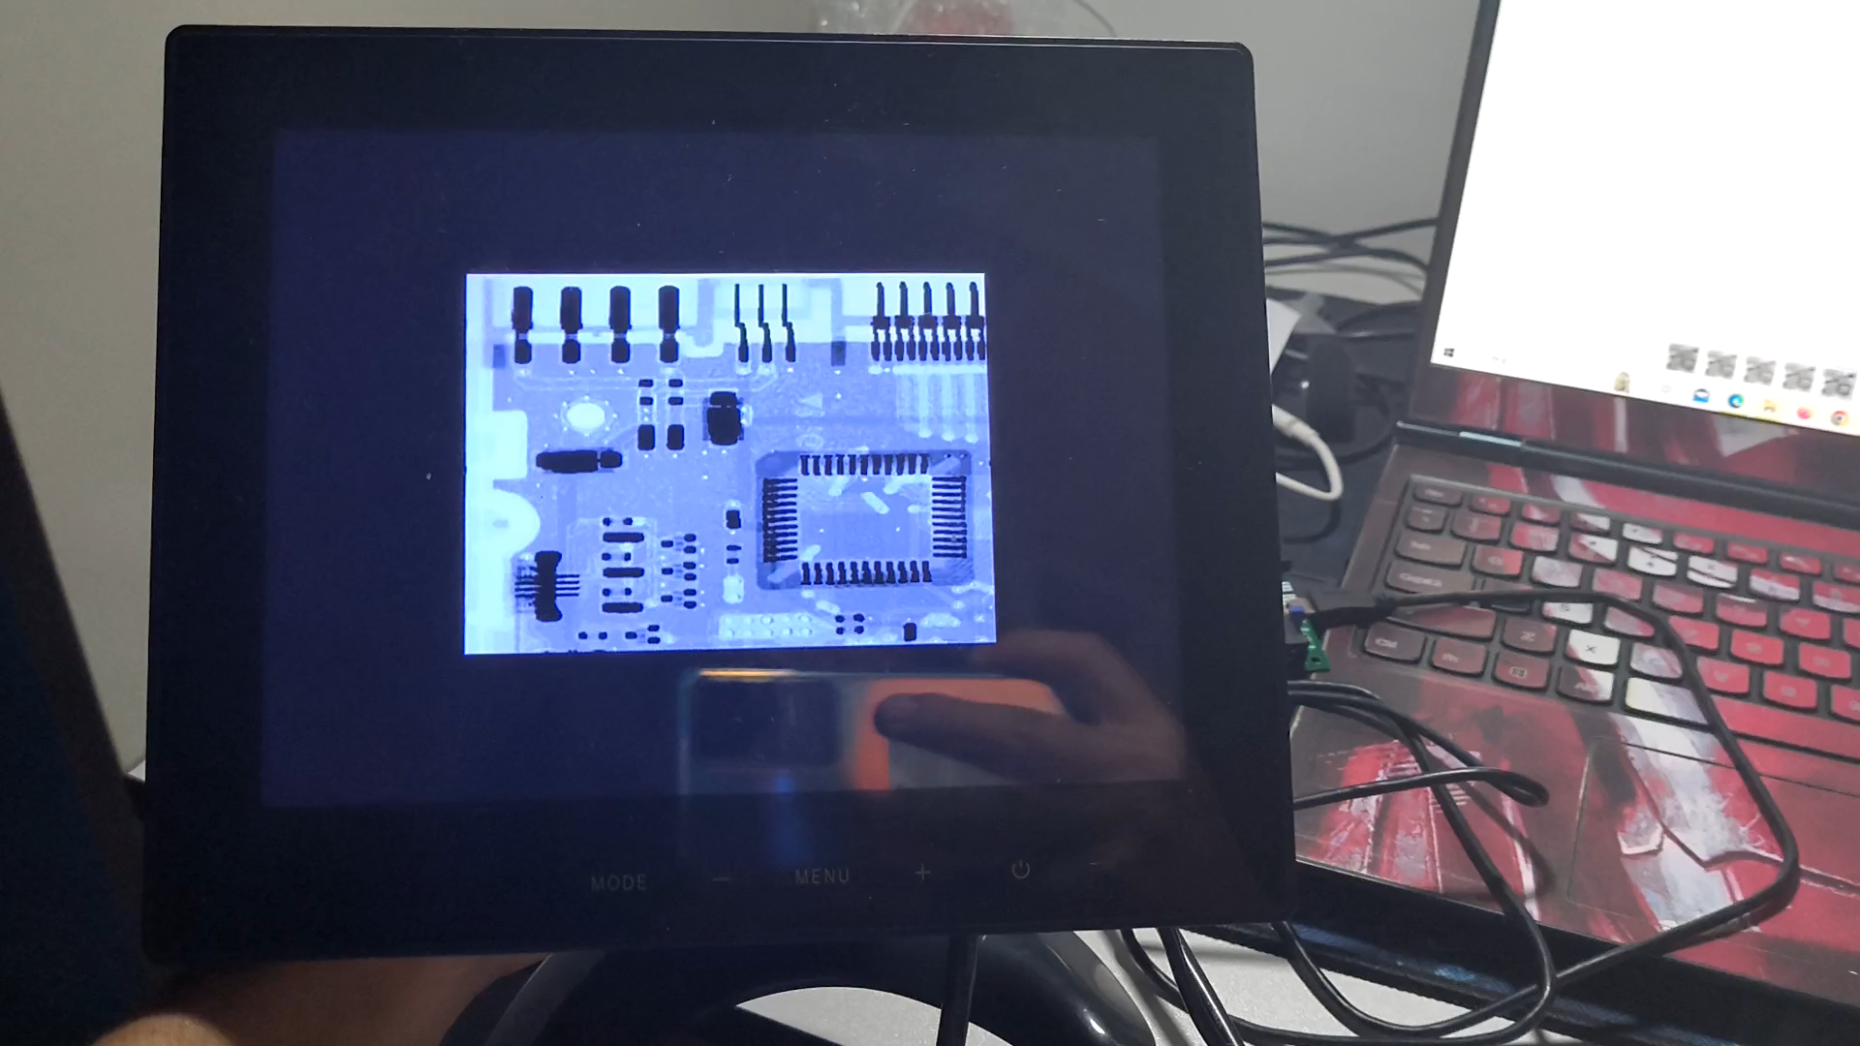
VGA display

Slide 12
Function and result
04
05
03

Slide 13
Expected time schedule
9-11 week
14 week
The camera captures images and processes them into bit streams
Display color image in VGA mode
Integrity test and function expansion
12-13 week
Algorithm implementation and result analysis

Slide 14
Thanks !
05
05

